Slide 1

Class Design
Based on Chapter 14 of Bennett, McRobb and Farmer:
Object Oriented Systems Analysis and Design Using UML, (2nd Edition), McGraw Hill, 2002.

Slide 2
In This Lecture You Will Learn:
  How to apply criteria for good design
  How to design associations
  The impact of integrity constraints on design
  How to design operations
  The role of normalization in object design

Slide 3
Class Specification: Attributes
An attribute’s data type is declared in UML using the following syntax
name ‘:’ type-expression ‘=’ initial-value ‘{’property-string‘}’
Where
  name is the attribute name
  type-expression is its data type
  initial-value is the value the attribute is set to when the object is first created
  property-string describes a property of the attribute, such as constant or fixed
Notes:
Common primitive data types include Boolean (true or false), Character (any alphanumeric or special character), Integer (whole numbers) and Floating-Point (decimal numbers).In most object-oriented languages more complex data types, such as Money, String, Date, or Name can be constructed from the primitive data types or may be available in standard libraries.
The attribute name is the only feature of its declaration that is compulsory.

Slide 4
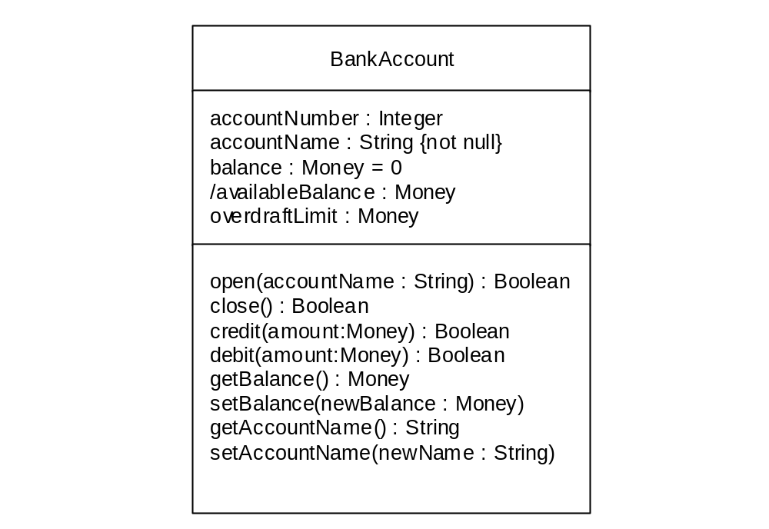
Class Specification: Attributes
Shows a derivable attribute
BankAccount class with the attribute data types included

Slide 5
Class Specification: Attributes
The attribute balance in a BankAccount class might be declared with an initial value of zero using the syntax
balance: Money = 0.00
Attributes that may not be null are specified
accountName: String {not null}
Arrays are specified
qualification[0..10]: String

Slide 6
Class Specification: Operations
The syntax used for an operation is
operation name ‘(’parameter-list ‘)’‘:’ return-type-expression
An operation’s signature is determined by the operation’s name, the number and type of its parameters and the type of the return value if any

Slide 7
Class Specification: Operations
BankAccount class with operation signatures included.

Slide 8
Which Operations?
Generally don’t show primary operations
Only show constructors where they have special significance
Varying levels of detail at different stages in the development cycle

Slide 9
Visibility
Visibility symbol
Visibility
Meaning
+
Public
The feature (an operation or an attribute) is directly accessible by an instance of any class.
-
Private
The feature may only be used by an instance the class that includes it.
#
Protected
The feature may be used either by the class that includes it or by a subclass or decendant of that class.
~
Package
The feature is directly accessible only by instances of a class in the same package.

Slide 10
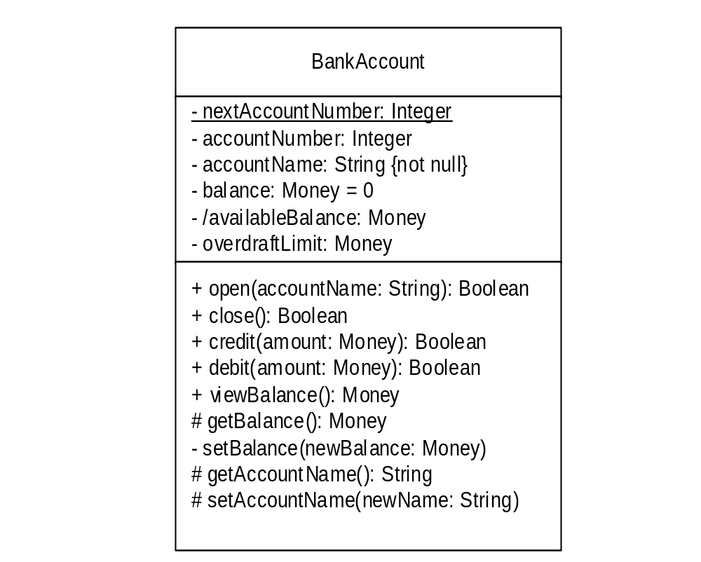
Visibility
BankAccount class with visibility specified

Slide 11
Interfaces
UML supports two notations to show interfaces
  The small circle icon showing no detail
  A stereotyped class icon with a list of the operations supported
  Normally only one of these notations is used on any one diagram
The realize relationship, represented by the dashed line with a triangular arrowhead, indicates that the client class (e.g. Advert) supports at least the operations listed in the interface

Slide 12
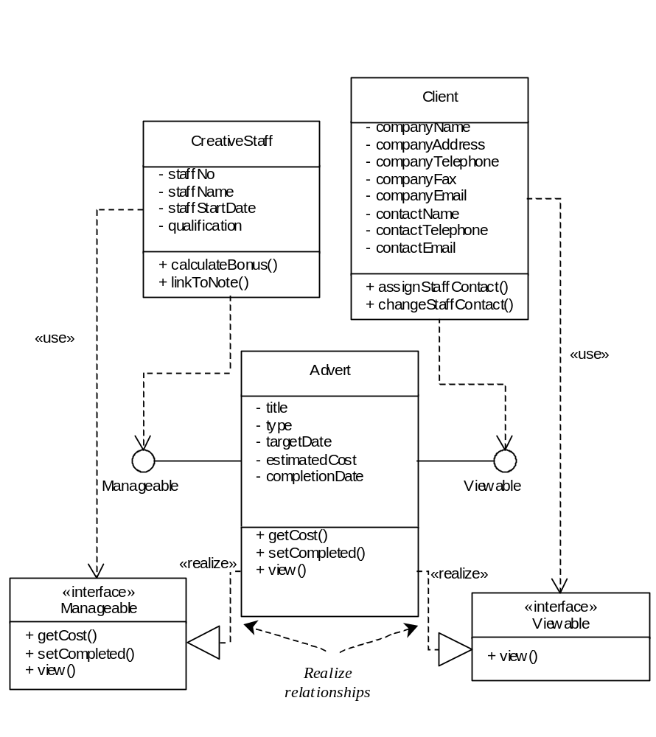
Interfaces for the Advert class

Slide 13
Criteria for Good Design: Coupling
Coupling describes the degree of interconnectedness between design components
It is reflected by the number of links an object has and by the degree of interaction the object has with other objects

Slide 14
Criteria for Good Design: Cohesion
Cohesion is a measure of the degree to which an element contributes to a single purpose
The concepts of coupling and cohesion are not mutually exclusive but actually support each other
Coad and Yourdon (1991) suggested several ways in which coupling and cohesion can be applied within an object-oriented approach

Slide 15
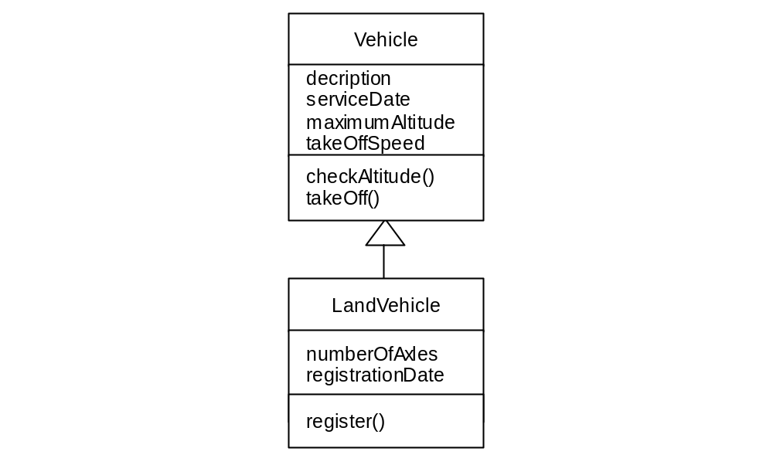
Inheritance Coupling
Poor inheritance coupling as unwanted attributes and operations are inherited
Inheritance Coupling describes the degree to which a subclass actually needs the features it inherits from its base class

Slide 16
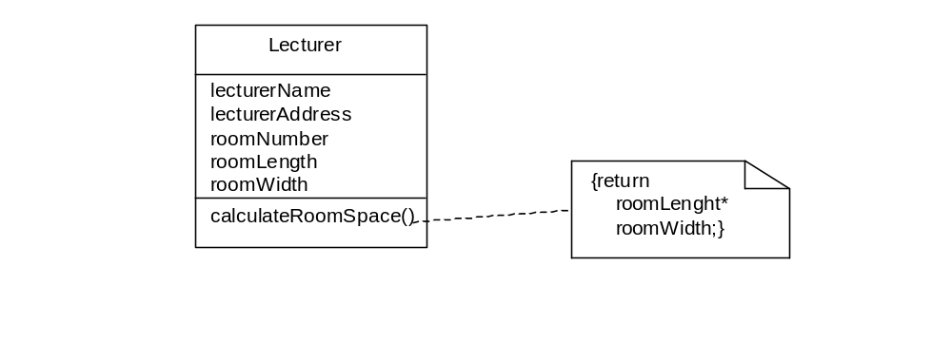
Operation Cohesion
Good operation cohesion but poor class cohesion

Slide 17
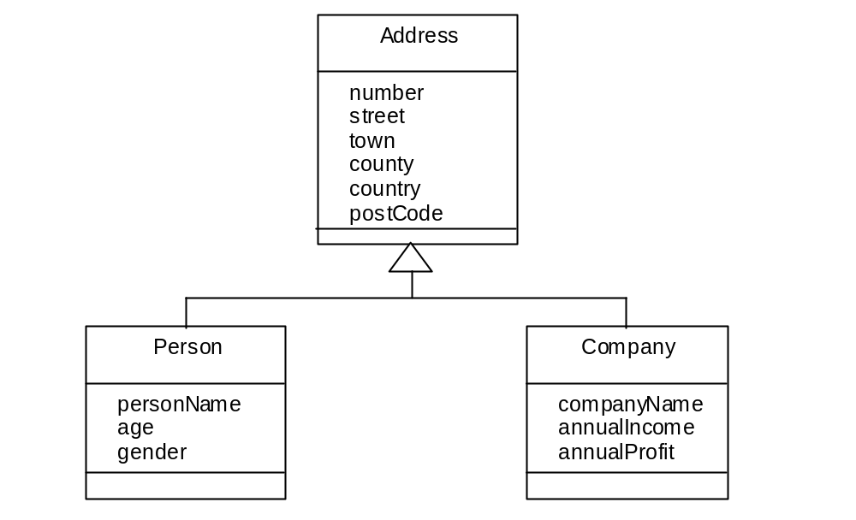
Poor Specialization Cohesion
Specialization Cohesion addresses the semantic cohesion of inheritance hierarchies

Slide 18
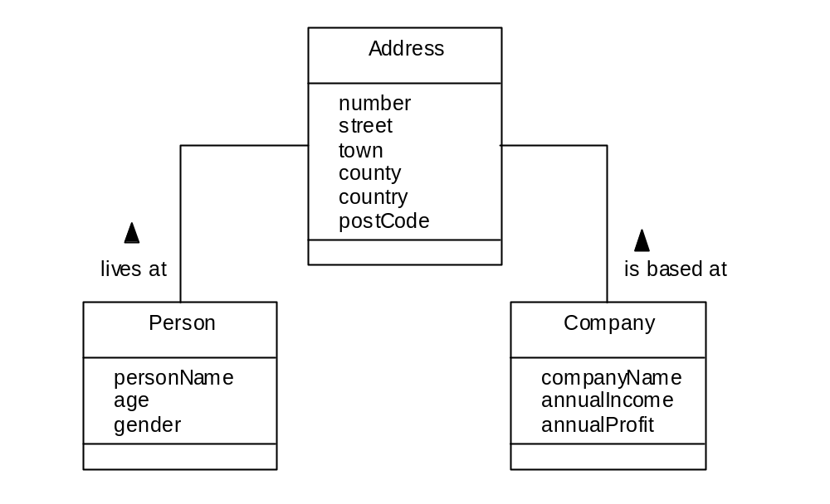
Improved Structure
Improved structure using Address class

Slide 19
Liskov Substitution Principle
Essentially the principle states that, in object interactions, it should be possible to treat a derived object as if it were a base object without integrity problems
If the principle is not applied then it may be possible to violate the integrity of the derived object

Slide 20
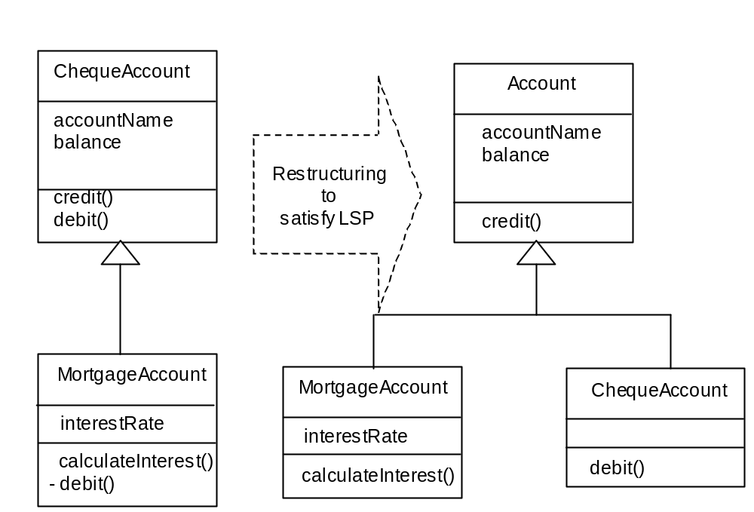
Liskov Substitution Principle
Disinheritance of debit() means that the left-hand hierarchy is not Liskov compliant

Slide 21
Further Design Guidelines
Design Clarity
Don’t Over-Design
Control Inheritance Hierarchies
Keep Messages and Operations Simple
Design Volatility
Evaluate by Scenario
Design by Delegation
Keep Classes Separate
Notes:
Design Clarity. A design should be made as easy to understand as possible. This reinforces the need to use design standards or protocols that have been specified.
Don’t Over-Design. Developers are on occasions tempted to produce designs that may not only satisfy current requirements but may also be capable of supporting a wide range of future requirements. Designing flexibility (or any other non-functional requirement) into a system has a cost, the system may take longer to design and construct but this may be offset in the future by easier and less expensive modification. However, it is not feasible to design for every eventuality. Systems that are over-designed in first instance are more difficult to extend if the modifications are not sympathetic to the existing structure.
Control Inheritance Hierarchies. Inheritance hierarchies should be neither too deep nor too shallow. If a hierarchy is too deep it is difficult for the developer to understand easily what features are inherited. There is a tendency for developers new to O-O to produce over-specialized hierarchies, thus adding complexity rather than reducing it. Yourdon (1994) suggests that hierarchies of up to nine levels are manageable, whereas Rumbaugh et al. (1991) suggest that more than about four or five levels is too many.
Keep Messages and Operations Simple. In general it is better to limit the number of parameters passed in a message to no more than three (of course, a single parameter might be a complete object). Ideally an operation should be capable of specification in no more than one page.
Design Volatility. A good design will be stable in response to changes in requirements. It is reasonable to expect some change in the design if the requirements are changed. However, any change in the design should be commensurate with the change in requirements. Enforcing encapsulation is a key factor in producing stable systems.
Evaluate by Scenario. An effective way of testing the suitability of a design is to role play it against the use cases using CRC cards if appropriate.
Design by Delegation. A complex object should be decomposed (if possible) into component objects forming a composition or aggregation. Behaviour can then be delegated to the component objects producing a group of objects that are easier to construct and maintain. This approach also improves reusability.
Keep Classes Separate. In general, it is better not to place one class inside another. The internal class is encapsulated by the other class and cannot be accessed independently. This reduces the flexibility of the system.

Slide 22
Designing Associations
Determine direction of message passing—i.e. the navigability of the association
In general an association between two classes A and B should be considered with the questions
  Do objects of class A have to send messages to objects of class B?
  Does an A object have to provide some other object with B object identifiers?
If yes then A needs Bs object identifier

Slide 23
Designing Associations
An association that has to support message passing in both directions is a two-way association
A two-way association is indicated with arrowheads at both ends
Minimizing the number of two-way associations keeps the coupling between objects as low as possible

Slide 24
Designing Associations
Arrowhead shows the direction in which messages can be sent.
Owner
Car
- name : String
- address : Address
- dateOfLicence : Date
numberOfConviction : Integer
ownedCar : Car
registrationNumber : Registration
make : String
model : String
colour : String
owns
1
1
carObjectId
is placed in the Owner class
One-way one-to-one association

Slide 25
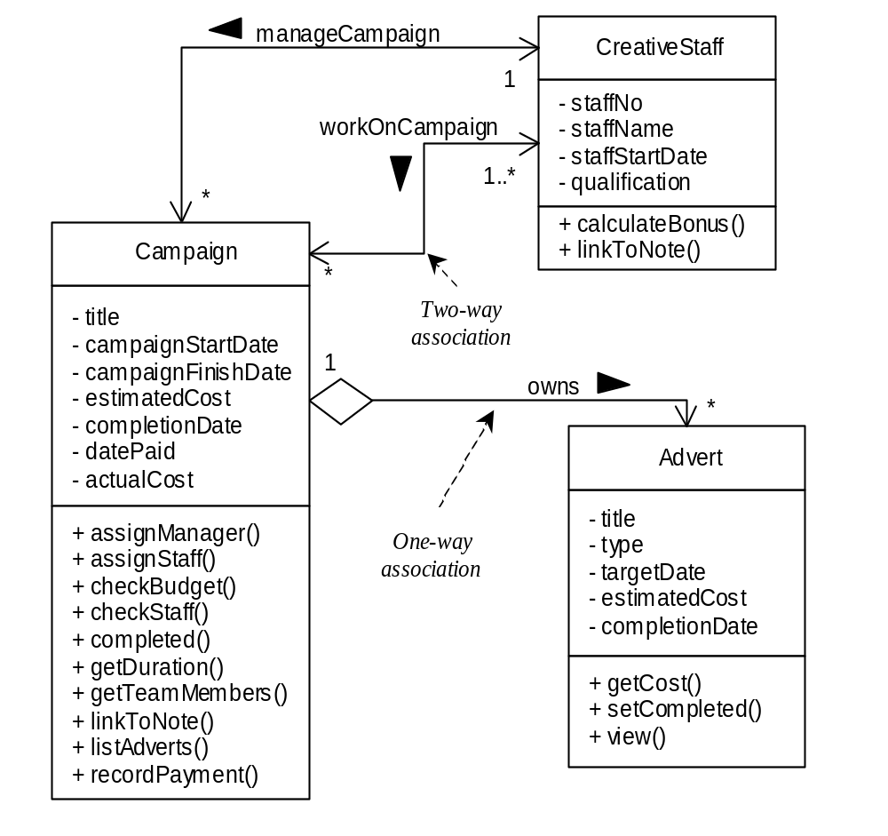
Fragment of class diagram for the Agate case study

Slide 26
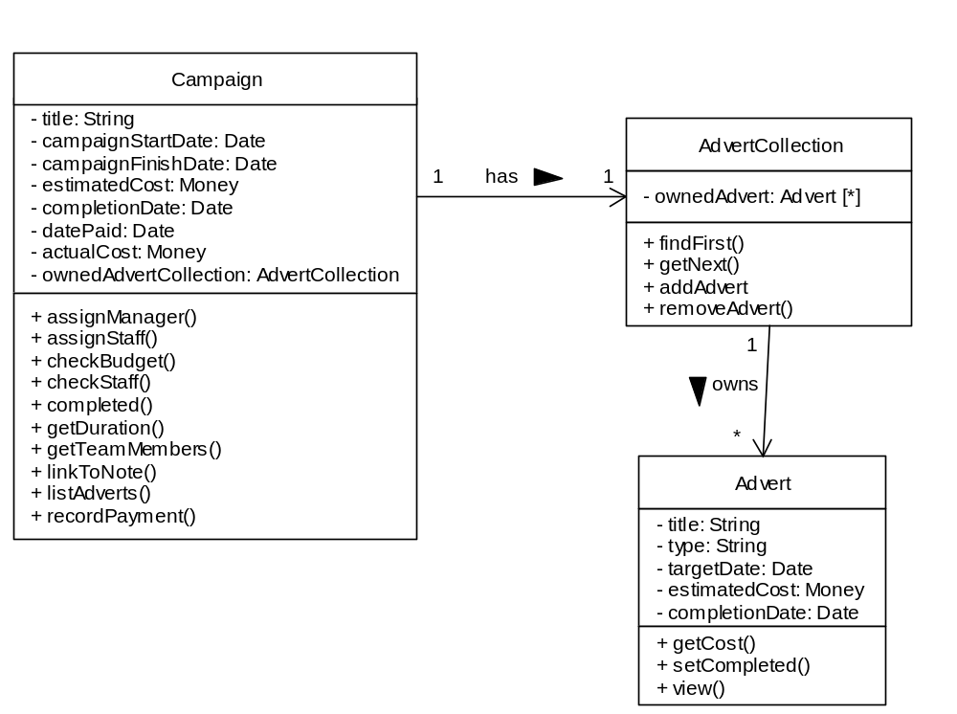
One-to-many association using a collection class.

Slide 27
Collection Classes
Collection classes are used to hold the object identifiers when message passing is required from one to many along an association
OO languages provide support for these requirements. Frequently the collection class may be implemented as part of the sending class (e.g. Campaign) as some form of list

Slide 28
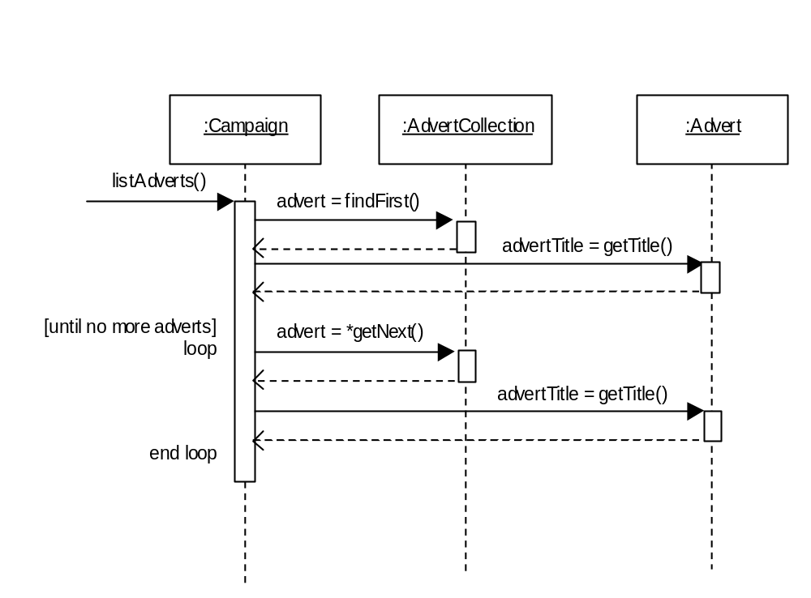
Sequence diagram for listAdverts()
This sequence diagram shows the interaction when using a collection class

Slide 29
Two-way Many-to-many Associations
CreativeStaff
1
StaffCollection
*
workOn
- staffCampaigns: CampaignCollection
- campaignStaff: Staff [*]
+ listCampaigns()
+ findFirst()
+ getNext()
+ addStaff()
+ removeStaff()
+ findStaff()
1
has
1
has
1
1
CampaignCollection
1
Campaign
*
- staffCampaign: Campaign [*]
- staffCollection: StaffCollection
workOn
+ findFirst()
+ getNext()
+ addCampaign()
+ removeCampaign()
+ findCampaign()
+ listStaff()
This is the design for the works On Campaign association

Slide 30
Integrity Constraints
Referential Integrity that ensures that an object identifier in an object is actually referring to an object that exists
Dependency Constraints that ensures that attribute dependencies, where one attribute may be calculated from other attributes, are maintained consistently
Domain Integrity that ensures that attributes only hold permissible values

Slide 31
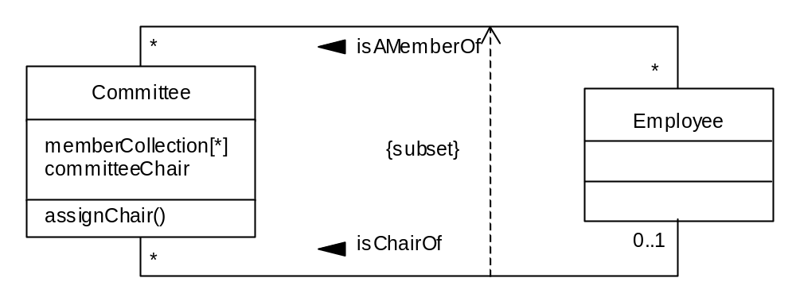
Constraints Between Associations

Slide 32
Designing Operations
Various factors constrain algorithm design:
  the cost of implementation
  performance constraints
  requirements for accuracy
  the capabilities of the implementation platform

Slide 33
Designing Operations
Factors that should be considered when choosing among alternative algorithm designs
  Computational complexity
  Ease of implementation and understandability
  Flexibility
  Fine-tuning the object model

Slide 34
Normalisation
Normalization may be useful in OO approaches
  when using a relational database management
  as a guide to decomposing a large, complex (and probably not very cohesive) objects
Objects need not be normalised but it is important to remove redundancy

Slide 35
Summary
In this lecture you have learned about:
  how to apply criteria for good design
  how to design associations
  the impact of integrity constraints on design
  how to design operations
  the role of normalization in object design

Slide 36
Designing Boundary Classes
Based on Chapter 17 of Bennett, McRobb and Farmer:
Object Oriented Systems Analysis and Design Using UML, (2nd Edition), McGraw Hill, 2002.

Slide 37
In This Lecture You Will Learn:
What we mean by the presentation layer
How prototyping can be applied to user interface design
How to add boundary classes to the class model
How to model boundary classes in sequence diagrams
How design patterns can be applied to the user interface
How to model control using statecharts

Slide 38
Architecture of the
Presentation Layer
We aim to separate the classes that have the responsibility for the interface with the user, or with other systems, (boundary classes) from the business classes (entity classes) and the classes that handle the application logic (control classes)
This is the Three-Tier Architecture
Notes:
Note that there may be more than three layers, and that the logical layers can map to physical platforms in a number of ways.

Slide 39
Presentation Layer
Handles interface with users and other systems
Formats and presents data at the interface
Presentation can be for display as text or charts, printing on a printer, speech synthesis, or formatting in XML to transfer to another system
Provides a mechanism for data entry by the user, but the events are handled by control classes

Slide 40
Presentation Layer
Does not contain business classes—Clients, Campaigns, Adverts, Invoices, Staff etc.
Does not contain the business logic—rules like ‘A Campaign must have one and only one Campaign Manager’.
Doesn’t handle validation, beyond perhaps simple checks on formatting

Slide 41
Reasons for the
3-Tier Architecture
Logical design
The project team may be producing analysis and design models that are independent of the hardware and software environment in which they are to be implemented. For this reason, the entity classes, which provide the functionality of the application, will not include details of how they will be displayed.
Interface independence
Even if display methods could be added to classes in the application, it would not make sense to do so. Object instances of any one class will be used in many different use cases: sometimes their attributes will be displayed on screen, sometimes printed by a printer. There will not necessarily be any standard layout of the attributes that can be built into the class definition, so presentation of the attributes is usually handled by another class.
Reuse
One of the aims is to produce classes that can be reused in different applications. For this to be possible, the classes should not be tied to a particular implementation environment or to a particular way of displaying the attribute values of instances.

Slide 42
3-Tier Architecture
Different authors have used different terms
  Boundary , Entity, Control
  Model, View, Controller
  Human Interaction Component, Problem Domain Component, Task Management Component
  (not necessarily in the same order)

Slide 43
Developing Boundary Classes
Prototype the user interface
Design the classes
Model the interaction involved in the interface
Model the control of the interface using statechart diagrams (if necessary)

Slide 44
Prototyping the User Interface
A prototype is a model that looks, and partly behaves, like the finished product but lacks certain features
A prototype of the user interface is a horizontal prototype—it prototypes one layer of the system
A vertical prototype takes a sub-system and prototypes all the layers

Slide 45
Prototyping the User Interface
Distinction between
  prototypes developed in an iterative process that are elaborated to become part of the eventual system and
  prototypes developed to test out design ideas that are thrown away rather than being further enhanced
  (actually, they are not really thrown away, as they form part of the design)

Slide 46
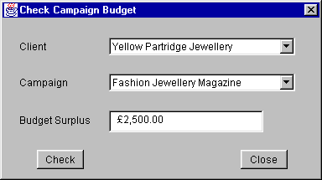
Check Campaign Budget
Use Case Prototype
In this prototype, Clients and Campaigns are selected in drop-down lists
There are other ways…

Slide 47
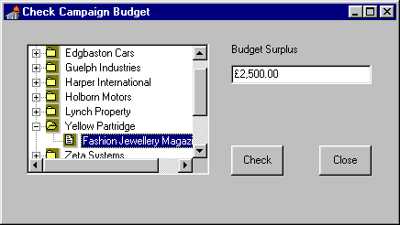
Check Campaign Budget
Use Case Prototype
Using a treeview control…

Slide 48
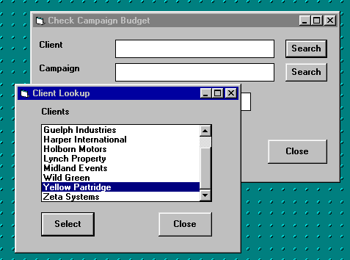
Check Campaign Budget
Use Case Prototype
Using a separate look-up window

Slide 49
Check campaign budget
Use Case Prototype
Choice of approach is part of the style guidelines discussed in Chapter 16
We are going to use the first approach, with drop-down lists
Although in Chapter 6, we looked at use cases for ‘Find campaign’, ‘Find client’ etc. as separate look-up windows, this approach is not what the Agate users want

Slide 50
Designing Classes
Start with the collaborations from the analysis model
Elaborate the collaborations to include necessary boundary, entity and control classes
Rosenberg and Scott (1999) treat control classes as placeholders—they represent some responsibility that has to be handled somewhere, but it may become an operation of another class

Slide 51
Collaboration for
Check campaign budget
Check Campaign Budget UI
Check Campaign Budget
Campaign
Advert
In order to find the right Campaign, we also need to use the Client class, even though it doesn’t participate in the real process of checking the budget
We also add control classes for the respons-ibilities of listing clients and campaigns

Slide 52
Collaboration for
Check campaign budget
List Clients
Client
Check Campaign Budget UI
Check Campaign Budget
Campaign
Advert
List Campaigns

Slide 53
Alternative Collaboration for
Check campaign budget
List Clients UI
List Clients
Client
Check Campaign Budget UI
Check Campaign Budget
Campaign
Advert
List Campaigns UI
List Campaigns

Slide 54
Class Diagram for CheckCampaignBudgetUI
Dialog
CheckCampaignBudgetUI
1
1
1
1
3
2
1
2
Label
Button
TextField
Choice

Slide 55
Single Class for CheckCampaignBudgetUI
Draw in your own lines to show which attribute is which element of the interface
CheckCampaignBudgetUI
- clientLabel : Label
- campaignLabel : Label
- budgetLabel : Label
- checkButton : Button
- closeButton : Button
- budgetTextField : TextField
- clientChoice : Choice
- campaignChoice : Choice

Slide 56
Package Dependencies
Classes can be shown with package names
AWT::Dialog
CheckCampaignBudgetUI
1
1
1
1
3
2
1
2
AWT::Label
AWT::Button
AWT::TextField
AWT::Choice

Slide 57
Package Dependencies
There is an «import» dependency between the two packages
  import java.awt.*; // In Java
  using System.Winforms; // in C#
AWT
«import»
Agate User
Interface

Slide 58
Sequence Diagrams
:Client
:Campaign
:Advert
Campaign
Manager
getName( )
listCampaigns( )
*getCampaignDetails( )
checkCampaignBudget( )
*getCost( )
getOverheads( )

Slide 59
Sequence Diagrams
The sequence diagram on the previous slide just shows the entity classes
We also have the collaboration diagram from an earlier slide showing the control and boundary classes
We now need to model the interaction more detail

Slide 60
First Part of Sequence Diagram
Campaign
Manager
:CheckCampaign
Budget
CheckCampaignBudget( )
ccbUI := Check
Campaign
BudgetUI( this )
:CheckCampaign
BudgetUI
:ListClients
lc := ListClients( )
listAllClients( ccbUI )
*addClientName( name )
enable( )

Slide 61
First Part of Sequence Diagram
The control class
  creates the instance of the boundary class
  creates the instance of the ListClients control class
  passes to :ListClients a reference to the boundary class
  :ListClients then sets the name of each client in turn into the boundary class by calling addClientname(name) repeatedly

Slide 62
Using Interfaces
We don’t mean user interfaces!
Many boundary classes will need to list clients to allow the user to select a client
The ListClients control class doesn’t need to know how the boundary class lists them
The boundary class needs to implement the ClientLister interface and provide an implementation of the operation addClientName(String)

Slide 63
Using Interfaces
Attributes can be private, only accessed through the public interface
«interface»
ClientLister
CheckCampaignBudgetUI
- clientLabel : Label
- campaignLabel : Label
+ addClientName(String)
- budgetLabel : Label
- checkButton : Button
«use»
- closeButton : Button
- budgetTextField : TextField
ListClients
- clientChoice : Choice
- campaignChoice : Choice
+ listAllClients(ClientLister)
+ enable( )

Slide 64
Java Implementation
import java.awt.*;
public class CheckCampaignBudgetUI extends
Frame implements ClientLister {
private Choice clientChoice;
...
public void addClientName(String name) {
clientChoice.addItem(name);
}
...
}

Slide 65
listAllClients( ) Operation
:ListClients
:ListClients
:Client
:Client
cl:ClientLister
:ClientLister
listAllClients( cl )
listAllClients( cl )
aClient := getNextClient( )
aClient := getNextClient( )
name := getName( )
name := getName( )
addClientName( name )
* [ while more clients ]
* [ while more clients ]

Slide 66
Second Part of Sequence Diagram
Campaign
Manager
:CheckCampaign
BudgetUI
:CheckCampaign
Budget
select client
clientSelected( )
aClient := getSelectedClient( )
:ListCampaigns
lc := ListCampaigns( )
listCampaigns( ccbUI, aClient )
*addCampaignName( name )
Notes:
Note that the :ListCampaigns object is using a CampaignLister interface to communicate with :CheckCampaignBudgetUI in the same way as :ListClients used the ClientLister interface.

Slide 67
Event-driven User Interface
Event in :clientChoice is passed through to the main boundary class
Campaign
Manager
clientChoice
:Choice
:CheckCampaign
BudgetUI
:CheckCampaign
Budget
select client
itemState
Changed( evt )
[evt.source = clientChoice] clientSelected( )

Slide 68
Revised Second Part of Sequence Diagram
Campaign
Manager
:CheckCampaign
BudgetUI
:CheckCampaign
Budget
select client
clientSelected( )
aClient := getSelectedClient( )
:ListCampaigns
lc := ListCampaigns( )
clearAllCampaignNames( )
listCampaigns( ccbUI, aClient )
*addCampaignName( name )
Notes:
clearAllCampaignNames() has been added to prevent more and more campaigns being added if a new client is selected.

Slide 69
Final Part of Sequence Diagram
Campaign
Manager
:CheckCampaign
BudgetUI
:CheckCampaign
Budget
:Campaign
:Advert
select campaign
campaignSelected( )
enableCheckButton( )
check budget
checkCampaignBudget( )
getCampaignSelected( )
checkCampaignBudget( )
*getCost( )
getOverheads( )
setBudget( )

Slide 70
Adding to the Class Diagram
From the sequence diagrams, we can see that the CheckCampaignBudgetUI class needs to implement both the ClientLister and the CampaignLister interfaces
There are also additional operations that have been introduced, some of which will apply to any class that implements these interfaces (and therefore belong to the interfaces), and some of which belong to the CheckCampaignBudgetUI class

Slide 71
ListCampaigns
«interface»
java::awt::event::ItemListener
+ listAllCampaigns(CampaignLister)
+ listCampaigns(CampaignLister, Client)
+ itemStateChanged(ItemEvent evt)
«use»
«interface»
CampaignLister
+ addCampaignName(String)
+ clearAllCampaignNames( )
+ removeCampaignName(String)
CheckCampaignBudgetUI
- clientLabel : Label
- campaignLabel : Label
«interface»
ClientLister
- budgetLabel : Label
- checkButton : Button
- closeButton : Button
+ addClientName(String)
+ clearAllClientNames( )
+ removeClientName(String)
- budgetTextField : TextField
- clientChoice : Choice
- campaignChoice : Choice
«use»
+ enable( )
+ enableCheckButton( )
+ getSelectedClient( )
+ getSelectedCampaign( )
+ setBudget(Currency)
ListClients
+ listAllClients(ClientLister)

Slide 72
Using Design Patterns
More and more, libraries of classes are built around design patterns
In Smalltalk, the Model–View–Controller architecture is widely used
In Java, an approach is used in which objects register an interest in events, then when an event occurs all the objects that have registered are notified of the event

Slide 73
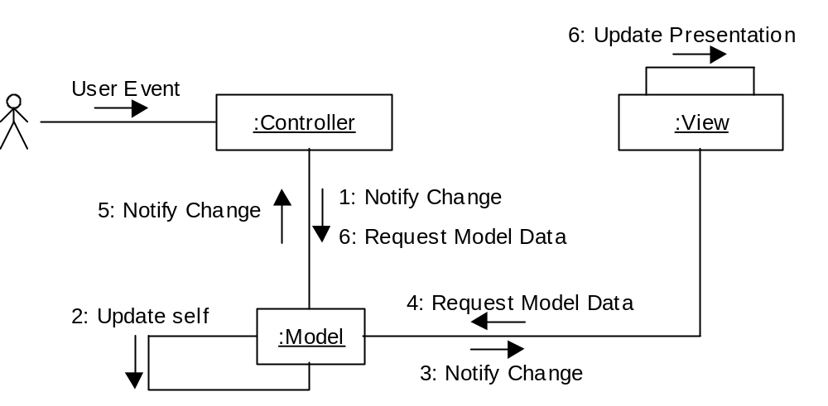
Model–View–Controller
/Controller
/View
/Model

Slide 74
Java Listener Approach
4 Update Self
User Event
:Component
:any:Class
1: itemStateChanged
(ItemEvent evt)
:ItemListener
2: Inspect Event
3: [Event of Interest]
Notify Class of Event

Slide 75
Java Approach
Various listeners for different kinds of user interface components
  MouseListener
  ItemListener
  ActionListener
All subinterfaces of EventListener

Slide 76
Java2 Enterprise
Edition (J2EE) Approach
J2EE is used for N-Tier distributed systems based on Enterprise Java Beans (EJB)
J2EE Core Patterns provides a pattern catalogue that uses the Model–View–Controller architecture

Slide 77
Modelling the User Interface in Statechart Diagrams
Different approaches to using statecharts
  Browne (1994), which was used in the 1st edition
  Horrocks (1999) used here
  Both based on the original work of Harel (1987)
  Recent work of Harel and Politi (1998)

Slide 78
Horrocks’ Approach
Five tasks:
  describe the high-level requirements and main user tasks
  describe the user interface behaviour
  define user interface rules
  draw the statechart (and successively refine it)
  prepare an event action table

Slide 79
High-level Requirements
The requirement here is that the users must be able to check whether the budget for an advertising campaign has been exceeded or not. This is calculated by summing the cost of all the adverts in a campaign, adding a percentage for overheads and subtracting the result from the planned budget. A negative value indicates that the budget has been overspent. This information is used by a campaign manager.

Slide 80
User Interface Behaviour
The client dropdown displays a list of clients. When a client is selected, their campaigns will be displayed in the campaign dropdown.
The campaign dropdown displays a list of campaigns belonging to the client selected in the client dropdown. When a campaign is selected the check button is enabled.
The budget textfield displays the result of the calculation to check the budget.
The check button causes the calculation of the budget balance to take place.
The close button closes the window and exits the use case.

Slide 81
Define User Interface Rules
User interface objects with constant behaviour
  The client dropdown has constant behaviour. Whenever a client is selected, a list of campaigns is loaded into the campaign dropdown
  The budget textfield is initially empty. It is cleared whenever a new client is selected or a new campaign is selected. It is not editable
  The close button may be pressed at any time to close the window

Slide 82
Define User Interface Rules
User interface objects with varying behaviour
  The campaign dropdown is initially disabled. No campaign can be selected until a client has been selected. Once it has been loaded with a list of campaigns it is enabled
  The check button is initially disabled. It is enabled when a campaign is selected. It is disabled whenever a new client is selected

Slide 83
Define User Interface Rules
Entry and exit events
  The window is entered from the main window when the Check Campaign Budget menu item is selected
  When the close button is clicked, an alert dialogue is displayed. This asks ‘Close window? Are you sure?’ and displays two buttons labelled ‘OK’ and ‘Cancel’. If ‘OK’ is clicked the window is exited; if ‘Cancel’ is clicked then it carries on in the state it was in before the close button was clicked

Slide 84
Draw the Statechart
We start with the top-level statechart for movement between the windows and dialogues
Main Window
checkCampaignBudget
MenuSelected( )
‘OK’
Check Budget
Window
closeButtonClicked( )
Alert Dialogue
‘Cancel’

Slide 85
Draw the Statechart
Client selection states are nested within the Check Budget Window state
No Client
Selected
clientSelected( )
Client Selected
clientSelected( )

Slide 86
Draw the Statechart
Campaign selection states are nested within the Client Selected state
No Campaign
Selected
campaignSelected( )
Campaign
Selected
campaignSelected( )

Slide 87
Draw the Statechart
Display of result states are nested within Campaign Selected state
Blank
checkButtonPressed( )
Display
Result
checkButtonPressed( )

Slide 88
Main Window
‘OK’
7 Alert Dialogue
‘Cancel’
checkCampaignBudget
MenuSelected( )
closeButtonClicked( )
Check Budget Window
H*
1 No Client
Selected
clientSelected( )
clientSelected( )
2 Client Selected
3 No Campaign
Selected
campaignSelected( )
campaignSelected( )
4 Campaign Selected
5 Blank
checkButtonPressed( )
6 Display
Result
checkButtonPressed( )

Slide 89
Draw the Statechart
Non-UML features:
  Horrocks numbers the states
  State variables can be shown in square brackets
Statechart can be simplified (as on next slide)
Rather than try to add all messages associated with transitions into the diagram, an Event–Action table can be used

Slide 90
Main Window
‘OK’
5 Alert Dialogue
‘Cancel’
checkCampaignBudget
MenuSelected( )
closeButtonClicked( )
Check Budget Window
H*
1 No Client
Selected
clientSelected( )
clientSelected( )
2 No Campaign
Selected
campaignSelected( )
campaignSelected( )
3 Blank
checkButtonPressed( )
4 Display
Result
checkButtonPressed( )

Slide 91
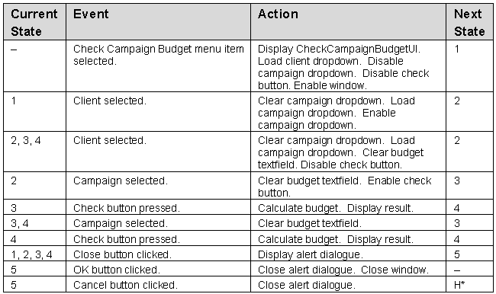
Event–Action Table

Slide 92
Revising the Sequence Diagrams and Class Diagrams
Producing the statechart diagram and the event–action table has identified some additional messages that will be sent to the user interface to control it
These will need to be added to the sequence diagrams and to the class diagram as operations of the UI class or of the lister interfaces

Slide 93
Revised First Sequence Diagram
Campaign
Manager
:CheckCampaign
Budget
CheckCampaignBudget( )
ccbUI := Check
Campaign
BudgetUI( this )
:CheckCampaign
BudgetUI
:ListClients
lc := ListClients( )
listAllClients( ccbUI )
*addClientName( name )
enable( )
disableCampaignList( )
disableCheckButton( )

Slide 94
Summary
In this lecture you have learned about:
What we mean by the presentation layer
How prototyping can be applied to user interface design
How to add boundary classes to the class model
How to model boundary classes in sequence diagrams
How design patterns can be applied to the user interface
How to model control using statecharts

